Slide 1
Thinking Positively about the Future
Chapter 9

Slide 2

Imagine Your Future

Slide 3


Slide 4

Let’s Visualize Your Future

Slide 5

As a college student:
Visualize yourself in your cap and gown walking across the stage to receive your diploma.

Slide 6
Exercise:
Visualize Your Success
Draw a picture, make a list or write some sentences.
Share with the class

Slide 7

Powerful Tools for Success
Optimism
Hope
Future-Mindedness

Slide 8

Believe in Yourself
If we have positive beliefs about ourselves, we will feel confident and accomplish our life goals.

Slide 9
Beliefs:
Personal opinions about yourself, your life and the world around you

Slide 10
For Example
If I believe I am not good in math, I may not do the assignment or may even avoid taking math.
If I believe I can be good in math, I can take the steps needed to be successful.

Slide 11
The Self-Fulfilling Prophecy
Our expectations influence our behaviors.
The behavior causes our expectations to come true.

Slide 12
Robert Rosenthal
Did experiments on the “self-fulfilling prophecy.”
Positive expectations led to positive outcomes.

Slide 13

Positive Self-Talk
The thoughts or silent inner voice in our heads

Slide 14

Negative Thoughts
Can be toxic to the body
Can cause biochemical changes that lead to depression

Slide 15

Positive Thoughts
Build good self-esteem
Help us to become confident in our abilities
Help us to achieve our life goals

Slide 16
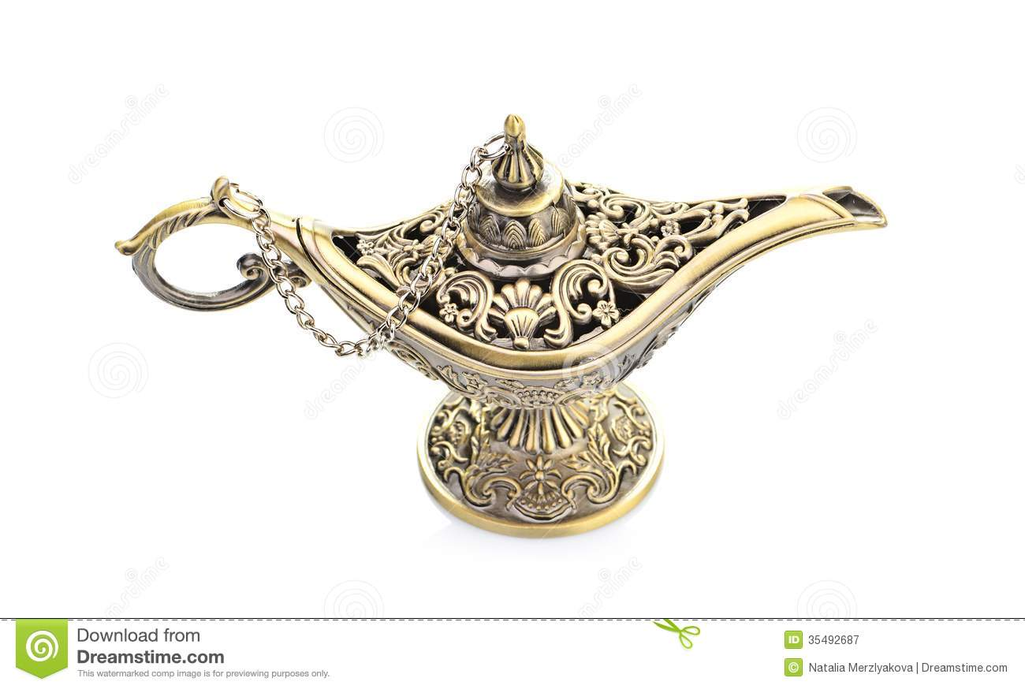
On a sunny beautiful San Diego day you are walking on the beach and suddenly to stub you toe on something in the sand.
Affirmations
You look down and see something is stuck in the sand. You bend over and pick it up. You brush off the sand off, It’s a lamp!

Slide 17
The lamp tells you it will grant you 3 wishes with the following
conditions.
1. You cannot wish for money
2. You cannot wish for more wishes
3. It must be for you
4. It must me realistic
What three wishes would you wish for?

Slide 18
Change the wishes to affirmations
Example:
The wish: I wish for good health.
The affirmation: I enjoy having good health.
Share your affirmations statements with the class

Slide 19

About Your Life and Your Future

Slide 20
Guidelines for Increasing Positive Thoughts
Monitor your thoughts. Are they positive or negative?
When you notice a negative thought, imagine rewinding the message and recording a new positive message.

Slide 21
Guidelines for Increasing Positive Thoughts
Start the positive message with “I” and use the present tense.
Make your affirmation stronger by visualizing what you want to achieve.
Repeat positive thoughts to yourself until they become a habit.

Slide 22
Athletes Use Visualization
A good way to practice
Helps you to pre-experience events in your mind
For example, pole-vaulters imagine the perfect jump before they make it

Slide 23
Visualization
We create all things twice.
  Make a mental picture.
  Create the physical reality by taking action.

Slide 24
For example:
In building a house we
  Create a blueprint or plan
  Then we build the house

Slide 25
Hope for the Best
Believing that you can be successful helps you to be successful.
Hopeful students are more successful.

Slide 26

Seven Habits of Highly Successful People

Slide 27
Be Proactive
Accept responsibility for your life.

Slide 28
Begin with the end in mind.
Know what is important.
What do you want to accomplish in your life?

Slide 29
Put first things first.
Set priorities.

Slide 30
Think win-win.
Seek solutions that benefit everyone.
Focus on cooperation rather than competition.

Slide 31
First seek to understand. Then be understood.
Listening is the first step in effective communication.

Slide 32
Synergize.
The whole is greater than the sum of its parts.
Working together as a team, you can accomplish more than each member can accomplish separately.

Slide 33
Sharpen the saw.
Invest time in yourself to stay healthy:
  Physically
  Mentally
  Spiritually
  Socially

Slide 34
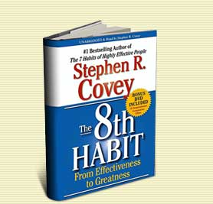
Find your voice and inspire others to find theirs.
Believe that you can make a difference in the world and inspire others to do the same.

Slide 35
Understanding Life Stages
Understand the present.
Take a glimpse into the future.

Slide 36
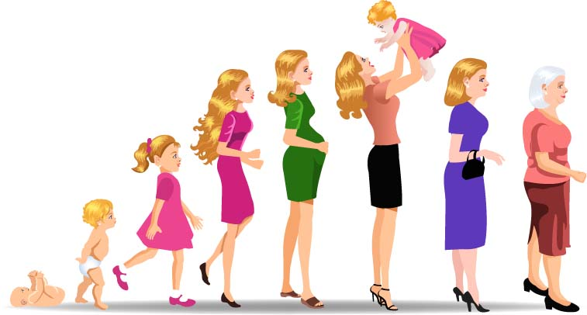
What is your life stage?
What comes next?

Slide 37
Erik Erikson
Human beings pass through 8 stages in a fixed order.
Each stage is a turning point.
The outcome of each stage is positive or negative.

Slide 38
Stage 1: Trust Vs. Mistrust
Age 0-1
If caregivers are consistent and caring, the child learns to trust the world as a safe place.
If the infant is abused or mistreated, he or she will learn that the world is an unsafe place.

Slide 39
Stage 2: Autonomy Vs. Shame and Doubt
Ages 1-3
Children learn to feel competent by feeding themselves, using the toilet and playing alone.
Or they learn to doubt their abilities.

Slide 40
Stage 3: Initiative Vs. Guilt
Ages 3-5
Children learn to plan their activities within their parents guidelines.
Or they develop guilt over their misbehavior.

Slide 41
Stage 4: Industry Vs. Inferiority
Ages 5-11
Children learn to meet the demands of teachers, parents and peers.
They learn that effort leads to success.
Or they develop a lifelong feeling of inferiority.

Slide 42
Stage 5: Identity Vs. Role Confusion
Ages 11-18
Children learn about their identity (personality, interests, values.)
They also learn about the world of work.
Or they develop confusion over their role in life.

Slide 43
Stage 6: Intimacy Vs. Isolation
Ages 18-40
A person develops a loving, committed relationship
Or the adult becomes isolated from others.

Slide 44
Stage 7: Generativity Vs. Stagnation
Ages 40-65
The adult contributes to future generations through raising children, helping others, developing products or coming up with creative new ideas.
Or the adult becomes stagnant and self-centered.

Slide 45
Stage 8: Integrity Vs. Despair
Ages 65+
People reap the benefits of all they have done.
They realize that life is temporary.
Or the individual struggles to find meaning in life.

Slide 46
Another Life Stage Theory
Daniel Levinson

Slide 47
Daniel Levinson
Adult development
Stages alternate between stable and transitional periods.
Stable periods last 6-7 years during which people pursue their goals and establish a structure.
Transitional periods last 4-5 years and adults change the structure.

Slide 48
What is Your Stage?
17-22 Transitional
22-28 Stable
28-33 Transitional
33-40 Stable
40-45 Transitional
45-50 Stable
50-55 Transitional
55-60 Stable

Slide 49
Another Theory:
Gail Sheehy
Author of Passages and
New Passages

Slide 50
Provisional Adulthood 18-30
Two opposing goals:
  Exploration-Who am I?
  Desire for stability

Slide 51
Provisional Adulthood 18-30
Age 30 is a turning point
  Feel confident in making choices without help from parents

Slide 52
Provisional Adulthood 18-30
Challenges
  Changing views on marriage
  Drugs, guns and violence
  Gap between rich and poor
  Rapid changes in the world

Slide 53
First Adulthood 30-45
At age 35 ask, “Is half of my life over?”
The beginning of mid-life crisis

Slide 54
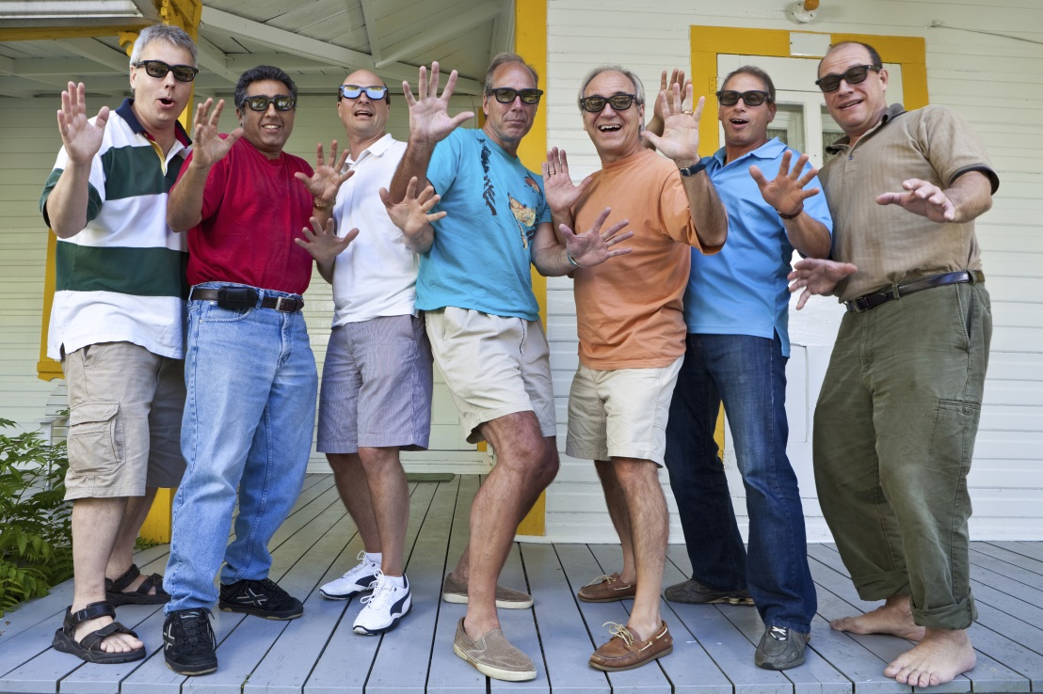
What is mid-life crisis?
A major transition in life in which we question what we did in the first half of life
Adults often make major changes in their lives
What changes have
you observed in adults
going through mid-life
crisis?

Slide 55
What is mid-life crisis?
Half of life is not over.
Half of life lies ahead.
A gateway to a new beginning of second adulthood

Slide 56
Second Adulthood Ages 45-85
Begins with the resolution of the mid-life crisis
  Age of Mastery 45-65
  Age of Integrity 65-85+

Slide 57
Age of Mastery 45-65
The apex of life
People have a sense of mastery and have experience with living.
Age 50 is the youth of second adulthood.

Slide 58
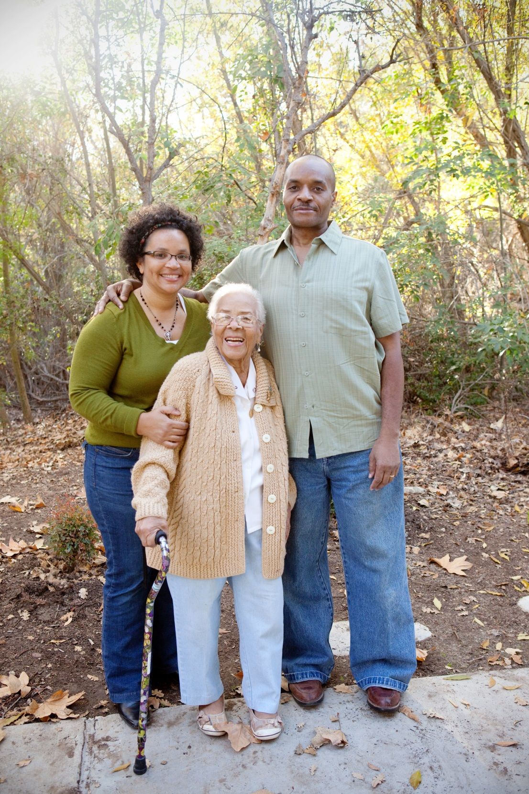
Successful Aging
Determine what is
important in life.
Take an active part
in life.
Find what you enjoy
and do it.

Slide 59
Age of Integrity 65-85+
Have learned how to live life
The retirement transition
Make contributions to family and community

Slide 60
Health and Wellbeing in the 60’s +
Mature love is more important than money or power
Continued growth and excitement about life
Exercise is the most important factor in retarding the aging process

Slide 61
Finding happiness in your life.

Slide 62
Steps to Happiness
Express gratitude.
Cultivate optimism.
Avoid over thinking and social comparison.
Practice acts of kindness.
Increase flow activities.

Slide 63
Steps to Happiness
Savor life’s joys.
Commit to accomplishing your goals.
Take care of your body.

Slide 64
Secrets to Happiness
Martin Seligman
Achieve happiness by identifying, cultivating, and using your personal strengths in work, love, play, and parenting.

Slide 65
Happiness = S + C + V
S is your set range (50% of happiness is determined by heredity)
C is your circumstance (8-15 % of happiness)
V is what is under your voluntary control (40%)

Slide 66
What are some examples of factors under your voluntary control?

Slide 67
More Secrets to Happiness

Slide 68
Secrets to Happiness
Happiness can’t be bought.
Happiness is more internal than external.
Happiness is not determined by age, race, gender or income.
Happiness won’t arrive in the Publisher’s Clearinghouse envelope.

Slide 69
Secrets to Happiness
Happiness depends less on things than on our attitude toward the things we have.

Slide 70
Make a decision to choose happiness.

Slide 71


Find small things that make you happy and sprinkle your life with them.

Slide 72
Laugh more. Laughter produces a relaxation response.

Slide 73

A good joke beats a pill for a lot of ailments.

Slide 74
Learn to think like an optimist. Assume you will succeed.

Slide 75


Replace negative thoughts with positive ones.

Slide 76
Do things that use your skills.

Slide 77
Fill your life with things you like to do. Remember the 20 things you like to do?

Slide 78
Get enough rest.

Slide 79
Exercise to feel good and to cope with anxiety.

Slide 80

There are no substitutes for fresh air, sunshine and exercise.

Slide 81
Reduce stress.

Slide 82


Close relationships are important.

Slide 83
If you don’t do anything else in life, love someone and let someone love you.

Slide 84

Keep things in perspective. Will it matter 10 years from now?

Slide 85
Exercise:
Happiness Is . . . .
Share Your Ideas

Slide 86
Keys to Success:
You Are What You Think

Slide 87
What we believe is true, comes true.
What we believe is possible, becomes possible.
--Henry Ford

Slide 88
Watch your thoughts; they become words.
Watch your words; they become actions.
Watch your actions; they become habits.
Watch your habits; they become character.
Watch your character; it becomes your destiny.
Frank Outlaw

Slide 89

Grand Essentials of Life

Slide 90

Grand Essentials of Life
Something to do (that you like)

Slide 91
Grand Essentials of Life
Something to do (that you like)
Someone to love

Slide 92

Grand Essentials of Life
Something to do (that you like)
Someone to love
Something to hope for

Slide 93

Use the tools in this book to create your success.

Slide 94
This is not the end of the course but a new beginning.

Slide 95
CONGRATULATIONS
Future
Graduates

Slide 96
Review the Keys to Success in this book. What is your favorite one and why?

Slide 97

Measure Your Success
Complete the exercise.
Pick up the one you did the first day of class.
Compare your results. Is your score higher?
Staple the two exercises together and hand them in.

Slide 98

Appreciating Island Cultures: Maui and His Magic Fish Hook
Read and discuss in class.

